Slide 1




EDA & EVALUATION RESULTS
E-Commerce
Product Categorization

Slide 2
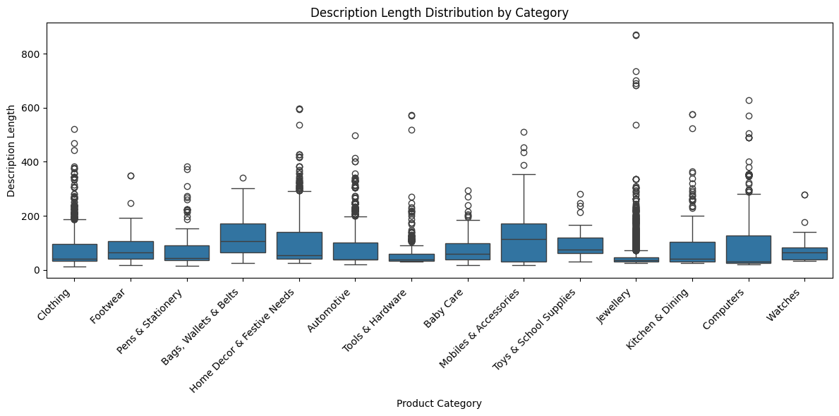

Description Length Distribution by Category
Descriptions for products in the “Mobiles & Accessories” category tend to be the longest, followed by “Kitchens & Dining” and “Computers.”
Descriptions for products in the “Clothing” ,”watches” and “Footwear” categories tend to be on the shorter side.

Slide 3
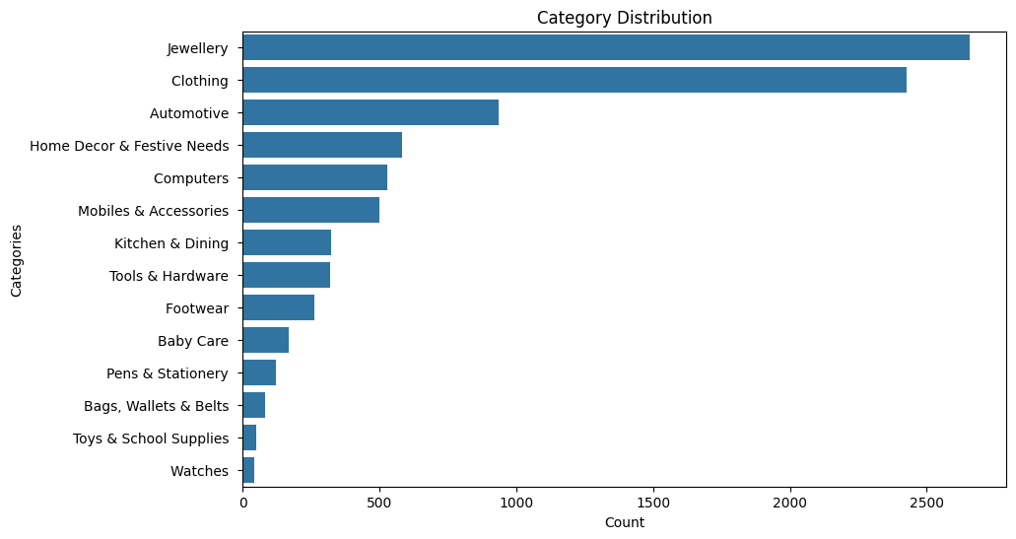
Category Distribution
Dataset contains more categories of “Clothing” followed by “Jewellery” and “Footwear”, this implies that customers are more interested in buying this products probably female customers

Slide 4
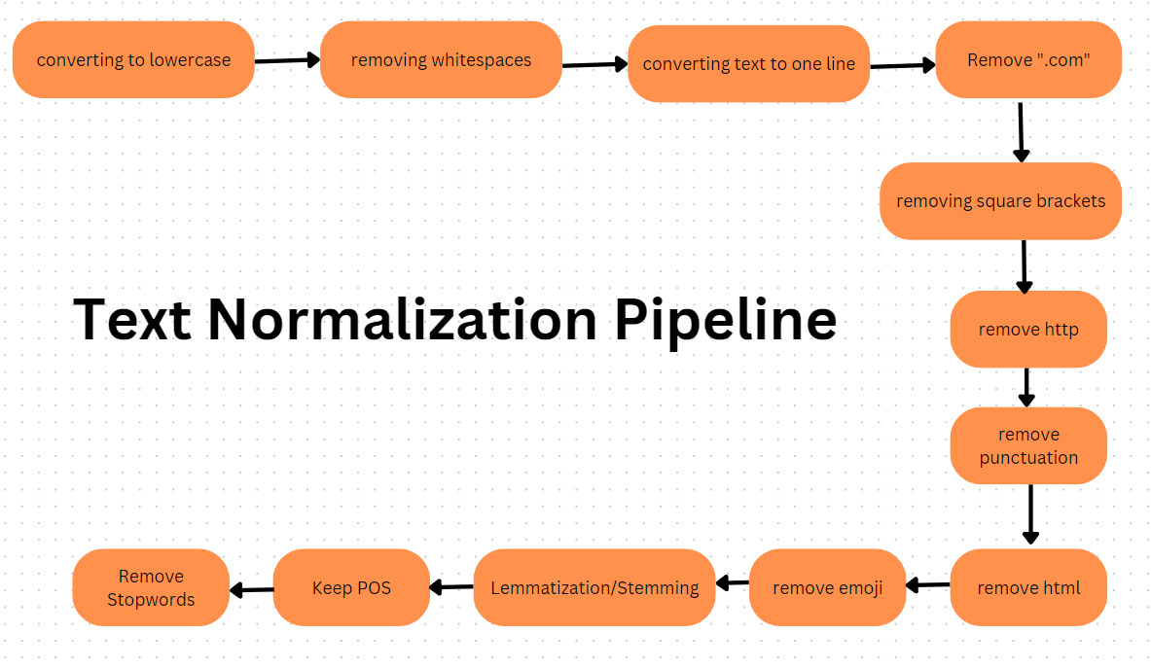
Text Normalization Pipeline

Slide 5
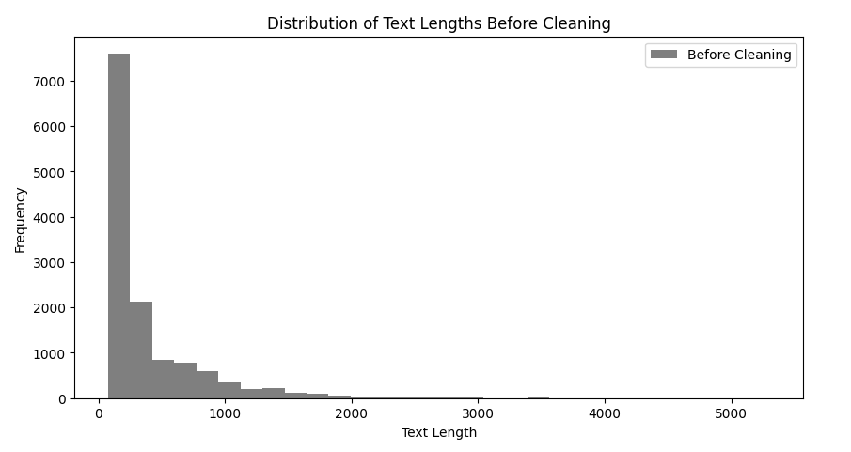
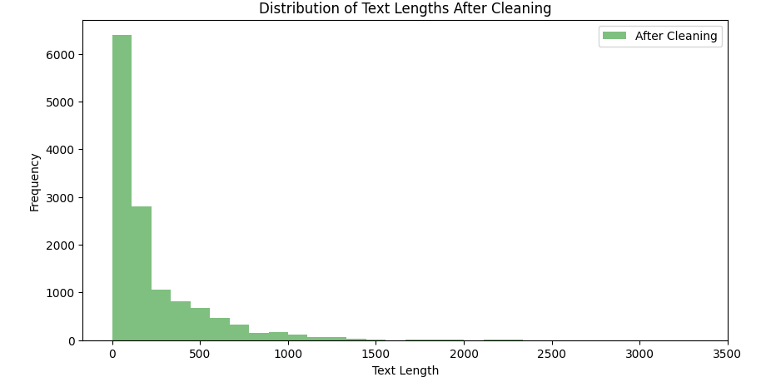
After Applying Normalization
Percentage reduction in text length after cleaning: 44.75%

Slide 6
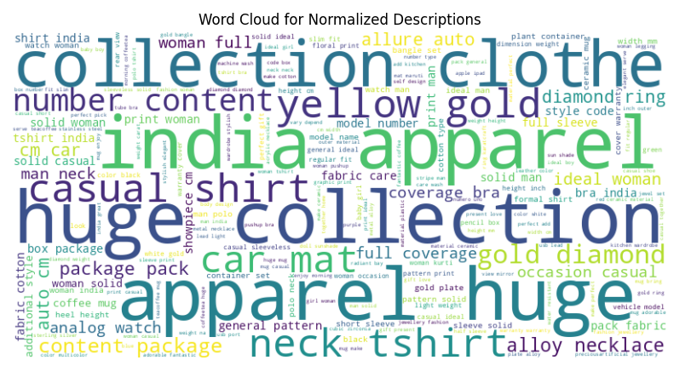
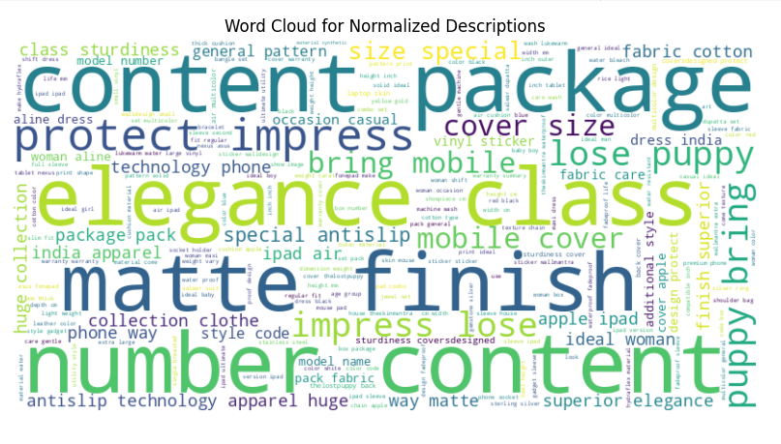
Word Distribution After Normalization
Training Data
Testing Data

Slide 7
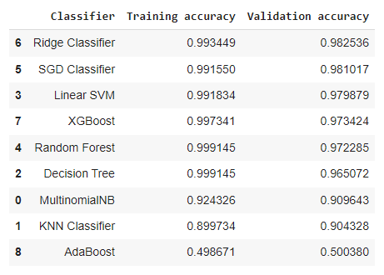
Applying Models on TF-IDF Vectorization
Ridge Classifiers performed best of all

Slide 8
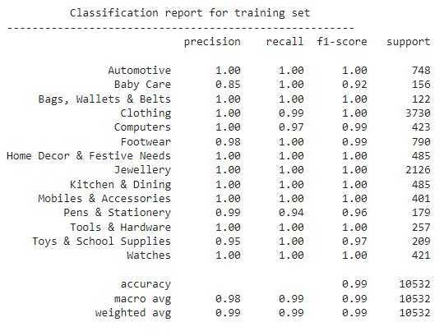
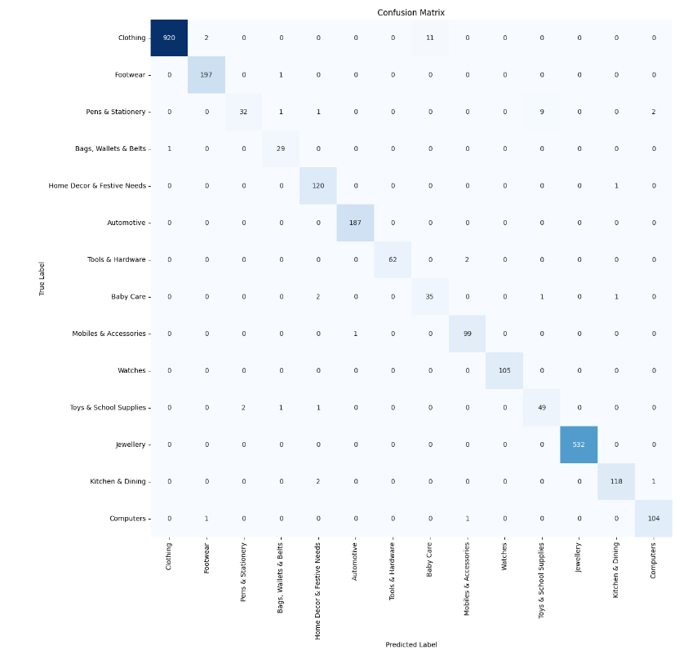
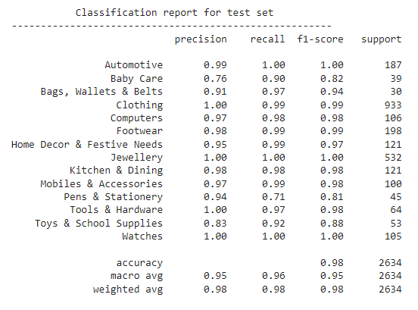
HyperParameter Tuning on Best Perfomed

Slide 9
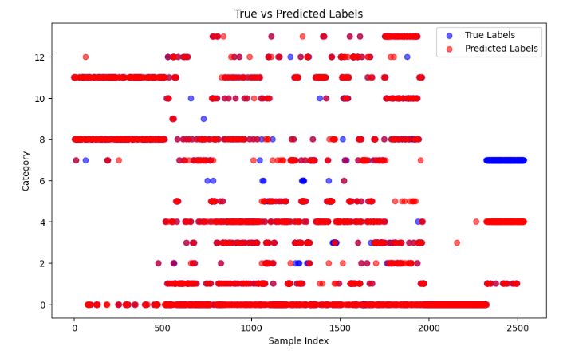
Prediction on Test Data
The model achieved a high accuracy of 85.83%, demonstrating strong performance in predicting product categories. The scatter plot analysis confirms this, showing substantial overlap between the true and predicted labels for most indices, indicating consistent and accurate predictions.
However, notable gaps between the blue and red points at specific indices (2300-2500), particularly within the 'Baby Care' category, highlight areas where the model struggles. Investigating these instances and categories can provide insights for targeted improvements.
Despite these challenges, the model shows promising overall performance. Implementing additional fine-tuning strategies, such as acquiring more training data for specific categories or conducting focused feature engineering, can further enhance accuracy and address identified weaknesses effectively.

Slide 10
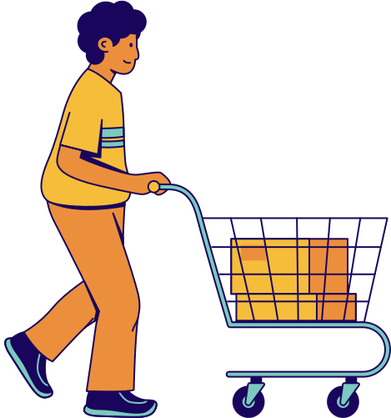
Thank you

